Slide 1
2023 Annual Meeting

Slide 2
Dr. Harry M. Davis, Ph.D., NCBA Professor of Banking, Department of Finance, Banking & Insurance, ASU
Keynote Speaker, Inflationary Trends and Considerations

Slide 3
“Is a Recession in the Near Term” Presented to REMDC Annual Meeting Chetola Lodge Resort Blowing Rock, NC
Harry M. Davis, Ph.D.
davishm@appstate.edu
NCBA Professor of Banking and Economist
Appalachian State University
May 22nd, 2023

Slide 4
The U.S. Economy
GDP growth last year was about 1%
Not in a recession – NBER
Since WWII, the US has had 12 recessions – the average duration has been 10 months
Consumer confidence remains relatively high and stable

Slide 5
The U.S. Economy
Housing and manufacturing are in recession
The service sector is carrying the economy
The ISM manufacturing index dropped under 50 for the last 6 months, ending in April.

Slide 6
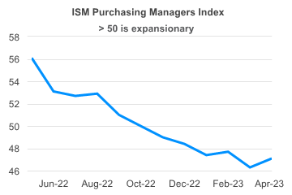

Slide 7
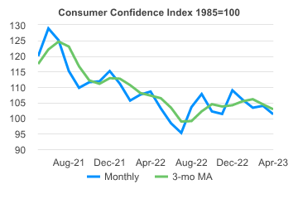

Slide 8
U.S. Economy
Average annual hourly earnings growth has declined from about 7% last summer to 4.4% through April
Low wage earners got the biggest bump

Slide 9
U.S. Economy ☹ ☹
The S&P 500 Stock Index declined about 20% last year while the NASDAQ Index declined over 30%
Go see a movie
Midterm elections
Cash is back

Slide 10
S&P 500 Stock Index

Slide 11
Real Estate ☹ ☹
Cost of building materials have increased over 35% since the start of the pandemic
The NAHB Index fell every month in 2022
The NAHB Index is up for the last 4 months, but remains under 50
Housing starts fell nearly every month last year and were down 25% through December

Slide 12
Real Estate ☹ ☹
The decline in starts for the year was the first since 2009
Multi family starts actually increased in 2022
5 million housing units short
Existing home sales fell about 37% last year, but have stabilized

Slide 13
Real Estate
Mortgage rates are now closer to 6% than 7%
The Case-Shiller housing price index declined in August for the first time since 2012 and then kept falling
Home prices are now down 3% since their peak in June 2022

Slide 15
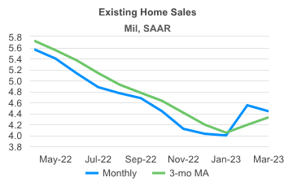

Slide 16
U.S. Employment
The unemployment rate dropped to 3.4% in April
The labor force participation rate is beginning to improve
About 2.1 million people entered the labor force between December and the end of April

Slide 17
U.S. Employment
There are about 9.6 million unfilled jobs
Boomers/Childcare/Eldercare/Drug use
Babysitters/$22
“Tooth fairy” – 16% increase last year

Slide 18
NC Economic Situation
The unemployment rate was 3.5% in March
Population grew almost 904,000 between 2010 and 2020 or by 9.5%
Immigration, not babies
Population growth very uneven – rural vs. urban

Slide 19
North Carolina
NC #1 for Business
Low taxes / Educational system / Pension plan / Rainy day fund
Mega business deals
Work force shortages

Slide 20
Median Household Income
NC has been sliding relative to the US
NC is likely closing the gap at present

Slide 21
The FED / Inflation
The rate of inflation (CPI) has dropped from about 9% to about 6% - the 2% target is not in sight
Wage/salary, food and rental price increases remain stubbornly high
The cost of food consumed at home increased 11.8% in 2022, the highest in 45 years
Gas/Brake Pedal/“Bank Event”

Slide 22
Federal Funds Rate

Slide 23
Bank Event
SVB/Signature
Uninsured deposits
Lumpy deposits
Debt Crisis / Delete Debt Ceiling ($31.4 T)

Slide 24
Economic Outlook
GDP growth will be about 0-1% this year
Inflation will decline to about 4% by year end
Expect the FED to raise rates an additional 25-50 basis points
Existing and new home sales and prices will be flat to slightly up this year

Slide 25
Economic Outlook
Mild recession for the US at the end of this year or beginning of 2024
NC will fare well in the next recession

Slide 26
Questions/Comments?

Slide 27
Afternoon Break is Sponsored by:

Slide 28
Inflation’s Impact on Distribution Co-op Costs and Power Prices and How To Deal With It

Slide 29
Chris Perry, President and CEO, Kentucky Electric Cooperative

Slide 30
The Supply Chain Challenge: Where are We and Where Are We going?
Chris Perry, Kentucky Electric Cooperatives

Slide 31
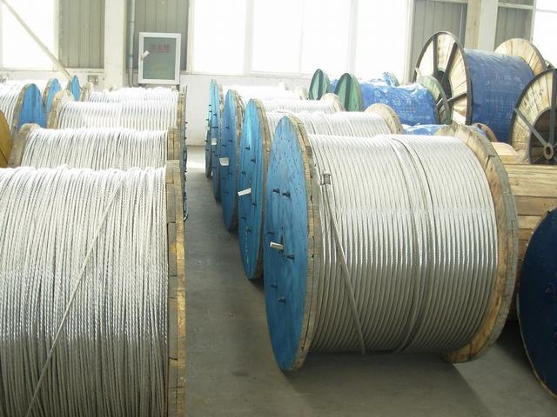
Overhead Cable +70%
Increase in
Sales Volume
(2019-2022)

Slide 32
Underground Cable +56%
Increase in
Sales Volume
(2019-2022)

Slide 33
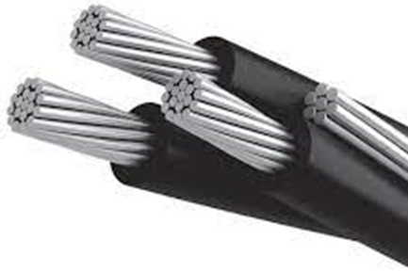
Increase in Price (2019-2022)
Sweetbriar +79%

Slide 34
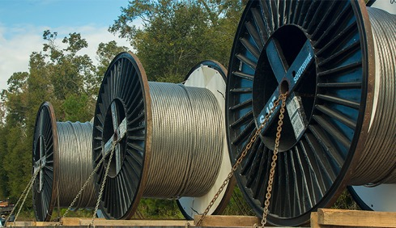
Lead Time Increase (2019-2022)
Cable
2019
2022
1 - 4
Weeks
42 - 52
Weeks

Slide 35
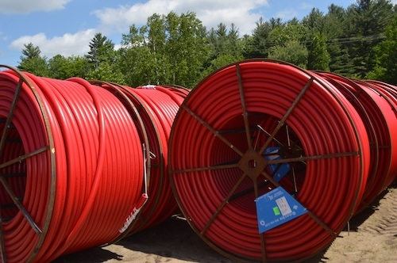
Lead Time Increase (2019-2022)
Conduit
2019
2022
2 - 4
Weeks
20 - 28
Weeks

Slide 36
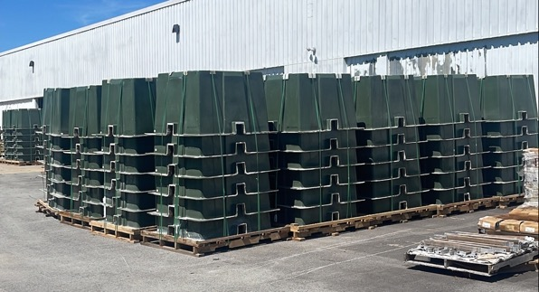
Box Pads +59%
Increase in
Sales Volume
(2019-2022)

Slide 37
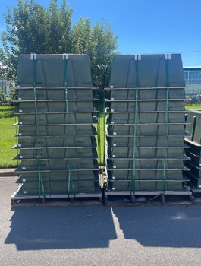
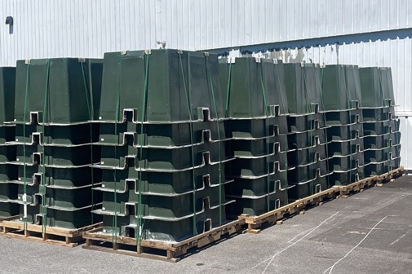
Increase in Price (2019-2022)
Box pads +60%

Slide 38
Increase in Price (2019-2022)
Industry- Wide
Transformers
+300% -
+600%

Slide 39
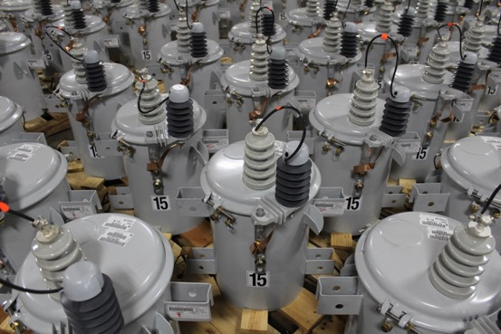
Increase in Price (2019-2022)
Transformers
+40%

Slide 40
Lead time increase (2019-2022)
Meter Bases
2019
2022
1 - 4
Weeks
8 - 42
Weeks

Slide 41
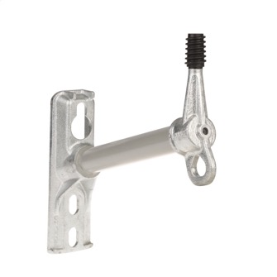
Lead Time Increase (2019-2022)
Standoff Brackets
2019
2022
3 - 4
Weeks
44 - 60
Weeks

Slide 42
The Transformer Market
Various estimates on the size of the distribution transformer market with consensus in the $4B - $6B range.
Seven manufacturers account for an estimated 95% of the total market
Market experts estimate a 5% – 7% annual growth rate for the foreseeable future
In addition to historical demand drivers, today’s market is heavily influenced by three emerging priorities:
Grid Hardening Actions
Renewable Energy (Wind, Solar, Battery)
EV Infrastructure Build Out
‘21/’22 may be an anomaly, but utilities and manufacturers reporting upwards of a 50% gap between demand and supply

Slide 43
Supply Chain
Labor
Materials
Transportation
Investments

Slide 44
Demand Side
Housing Growth
Manufacturing Investments
Federal Infrastructure Funding
Electric Vehicles
Grid Hardening
Energy Transition

Slide 45
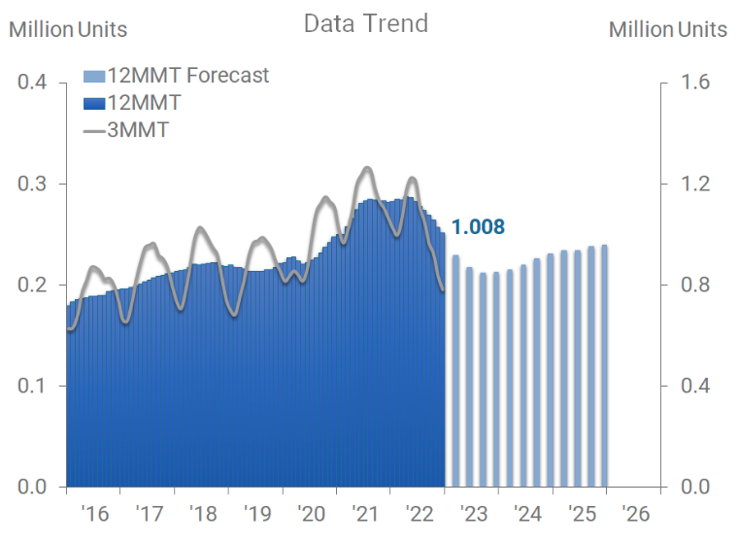
US Single-Unit Housing

Slide 46
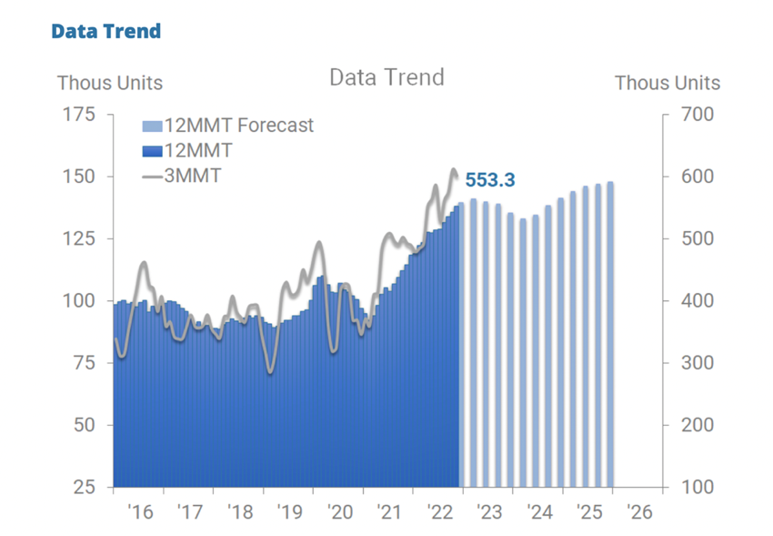

Slide 47
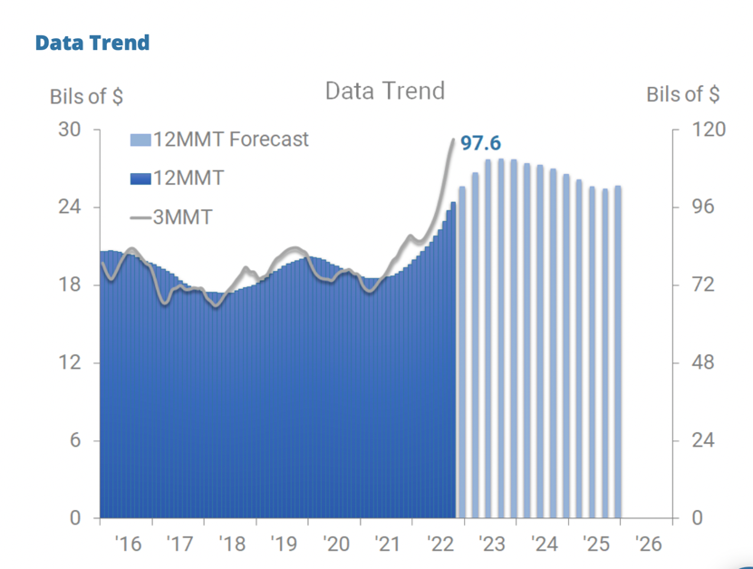
Private Manufacturing

Slide 49
~70%
US T&D lines more than 25 years old
2x
increase in outage lengths over last 10 years
>50%
US power supply from renewables by 2035
>30%
increase in length of US T&D grid
~40%
electric vehicle penetration by 2030
~50%
fiber-to-the-home penetration in US by 2025
$100B+
federal investment and financing to modernize electrical grid
Source: Hubbell

Slide 50
Supply Chain
Labor
Materials
Transportation
Investments

Slide 51
Supply-Side Constraints
Electrical Steel
Commodity Availability
Semi-Conductor Chips
Transportation
Global Supply Chain Dependence

Slide 53
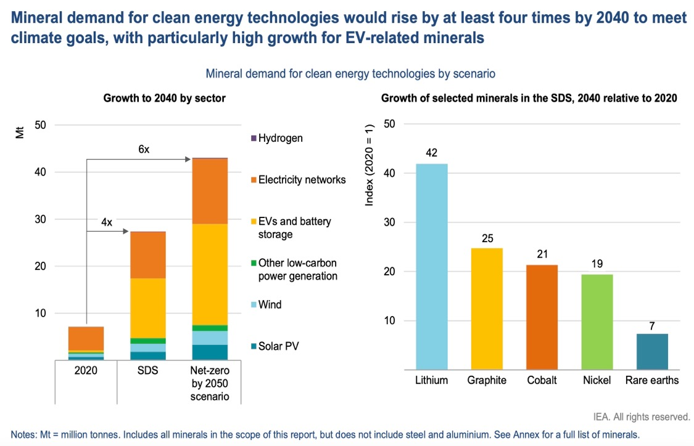

Slide 54
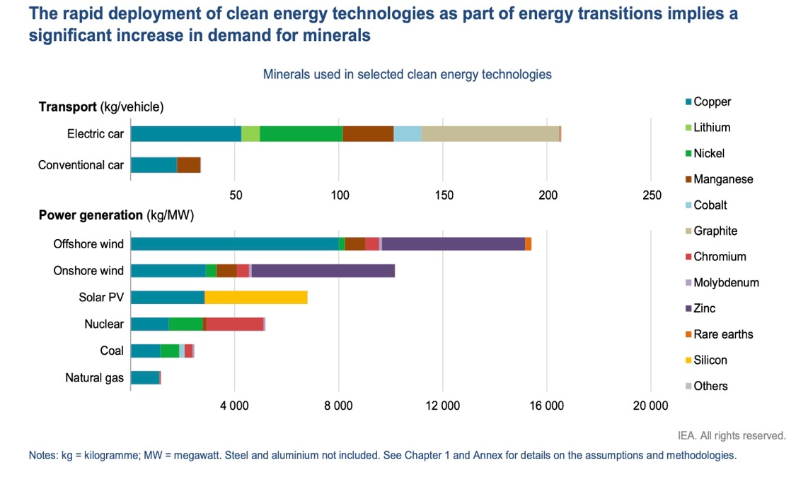

Slide 55
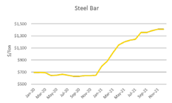
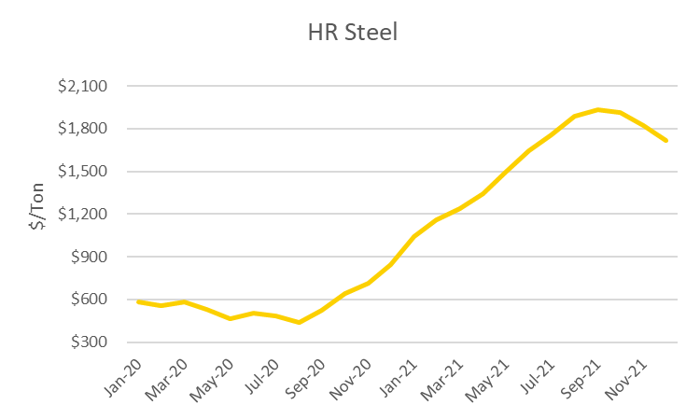
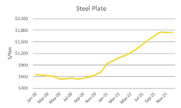
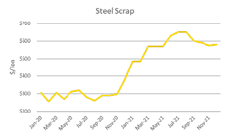
Steel
Steel prices have remained at or near record highs throughout 2021 driven by constrained supply and strong demand. Some categories such as hot rolled have come down from their peaks while others remain at record highs.
BAR
115%
Increase
$1205
3/3/22
$1029
2/23/22
$1800
2/23/22
PLATE
191%
Increase
201%
Increase vs 2020
95%
Increase
$615
3/4/22
SCRAP

Slide 56
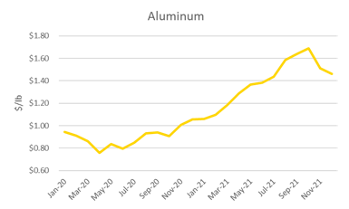
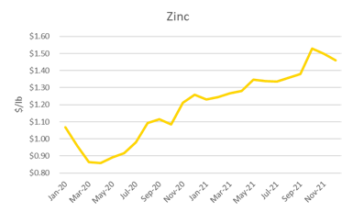
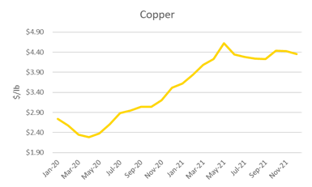
Non-Ferrous Metals
$2.01/lb
3/3/22
$1.84/lb
3/3/22
62%
Increase vs 2020
42%
Increase vs 2020
$4.78/lb
3/3/22
March 2022 Update
55%
Increase vs 2020
Costs for non-ferrous metals at record highs due to supply chain volatility associated with Ukraine/Russia.
Pandemic recovery and strong demand driving elevated prices.
Automobile industry may still push increased demand into 2022.

Slide 57
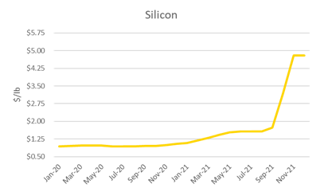
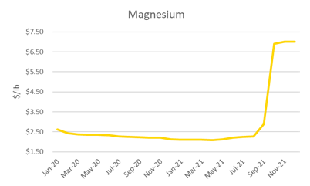
Other Materials
396%
Increase vs 2020
203%
Increase vs 2020
March 2022 Update
Silicon pricing has spiked since Sep driving up prices for silicone and metallic alloys.
Magnesium has also spiked over a similar timeframe.
Suppliers are adding price increases for these material components after contracts expire in 2021.
Prices expected to remain elevated through at least early 2022.

Slide 58
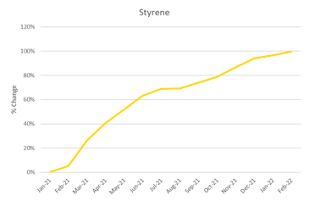
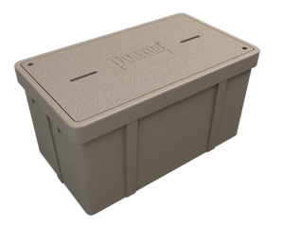
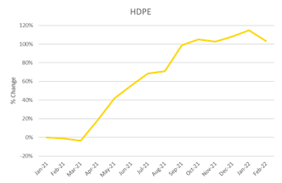
Resins
March 2022 Update
Prices for Styrene and HDPE resin pricing remains at/near record levels.
Tight supply is driving prices higher; Premiums often required to get raw material.
Styrene pricing is up nearly 10% since Dec. 2021; HDPE remains near highs.
100%
Increase vs Jan. 2021
103%
Increase vs Jan. 2021

Slide 59
Supply Chain
Labor
Materials
Transportation
Investments

Slide 60
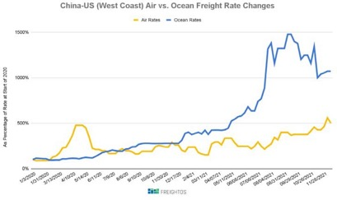
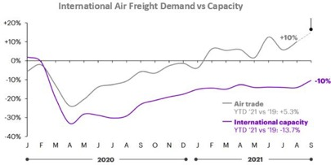
Air & Ocean Freight
March 2022 Update
Ocean container costs remain near record highs and port congestion continues to be a challenge.
1100%
Increase vs Jan. 2020
End-to-end transit time for China to U.S. ocean freight still exceeds 70+ days and delays often average weeks.
500%
Increase vs Jan. 2020
Manufacturers turning to air freight to surpass lengthy ocean transit times.
Little relief expected in the near team as challenges from COVID persist while demand remains extremely strong
10%
Increase in Demand
10%
Decrease in Capacity

Slide 61
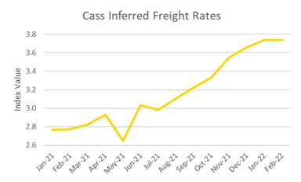
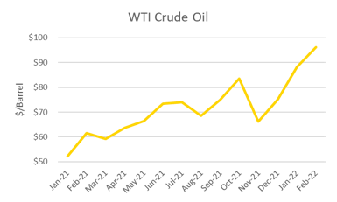
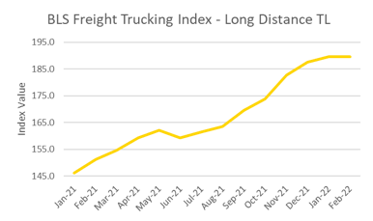
Domestic Freight
36%
Increase vs Jan. 2021
84%
Increase vs Jan. 2021
March 2022 Update
Significant new carrier rate increases ranging 20-35% take effect March 1st.
Active truck utilization at highest level on record; Expected to continue in foreseeable future.
The BLS index for long distance trucking has increased 30% vs Jan. 2021.
Fuel surcharges common with oil prices 80% higher vs Jan. 2021.
30%
Increase vs Jan. 2021

Slide 62
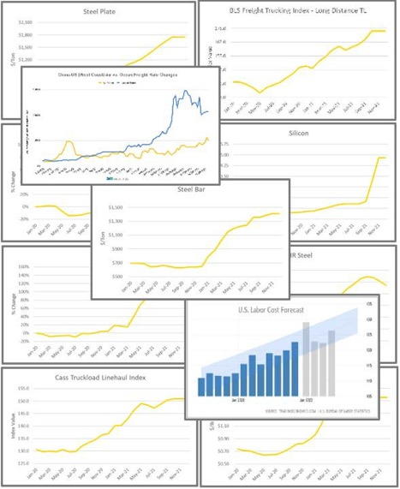
Rising Costs
Russia Global Production
6% Aluminum
5% Nickel
4% Crude Steel
35% Palladium
10% Platinum
Freight
1100% Ocean Freight
15-34% Domestic (additional 11% in 2022)
Steel stabilizing
Aluminum and Zinc at record highs
Copper, Magnesium near highs
Resins near record highs
Silicon near record highs
BUILD. MAINTAIN. MODERNIZE. | HUBBELLPOWERSYSTEMS.COM

Slide 63
Supply Chain
Labor
Materials
Transportation
Investments

Slide 64
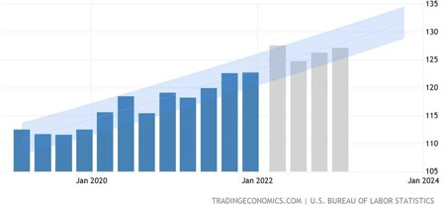
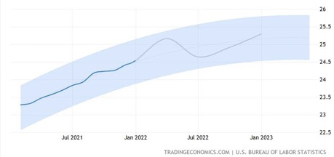
Labor
U.S. Labor Cost Forecast
March 2022 Update
12%
Projected 2022
Increase
Labor costs continue to be a headwind; 2022-2023 forecasts indicate further increases.
The U.S. Labor Cost Index is projected to increase 12% above 2021 levels in 2022 and another 4% in 2023.
Wage growth in U.S. manufacturing continues to rise; Forecasted to increase approximately 4%/year for next 3 years.
In addition to base wage increases, overtime hours have also increased substantially as manufacturers struggle to keep up with demand.
U.S. Hourly Wage Forecast - Manufacturing
10%
Projected 2022
Increase

Slide 66
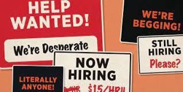
Distribution Transformer Constraints
Labor
Grain Oriented Electrical Steel (GOES)
Transformer Components

Slide 67
When Will it End and What to do?
Slight Moderation in Lead Times
Expect Inflation Drivers to Continue in our Market
Forecasts and Capital Budgets
Internal Communications Critical
Communicate with Suppliers
Communicate with Members, Developers, and Political Leaders

Slide 68
Brian Sheridan, Executive Director, Morgan Stanley

Slide 69
Questions/Comments?

Slide 70
Mark Allred, Director of Talent Development & Growth, Reveal Global Intelligence and
Purpose-Driven Recruitment
Inflation’s Impact on Attracting and Retaining Talent

Slide 71
Power up your hiring & retention
Purpose-Driven real-world solutions

Slide 72
MARK ALLRED
DIRECTOR OF TALENT DEVELOPMENT & Growth
Reveal Global Intelligence

Slide 73
agenda
UNDERSTANDING CURRENT REALITIES:
Economic Threats to Talent Acquisition & Retention
Attracting & Retaining the Next Generation of Workers
EXPLORING SOLUTIONS:
Assessing Your Hiring Strategy
Creating a Culture Worth Staying For

Slide 74
reality #1
Inflation hit a 40-year-high in June of 2022.
SHRM State of the Workplace Report 2022-2023
86%
Survey respondents who ranked inflation as their organization’s top concern.

Slide 75
Natural reactions to increased inflation that impact talent acquisition & retention
PAY HIGHER WAGES
Only 45% of recruitment pros say their companies increased salaries enough to keep pace with inflation.
55% of US companies reported an increase in recruiting costs due to inflation.
EVALUATE HIRING BUDGETS
According to the 2023 LinkedIn Future of Recruiting Report

Slide 76
reality #2
60%
of the rural electric industry's workforce is over the age of and many will be retiring in the next
45
10 years.
National Rural Electric Cooperative Association (NRECA) Report

Slide 77
A Proactive response to managing inflation & Attracting diverse talent
Reinvent your hiring & retention strategies
Attract emerging & passive talent
Hire for skill over experience
Make wise TA technology investments
Re-recruit your talent

Slide 78
Reinvent your hiring & Retention Strategy with a sense of purpose

Slide 79
PURPOSE-DRIVEN RECRUITMENT™
Care for the Business
Care for the Candidate

Slide 80
BUSINESS NEEDS
CANDIDATE NEEDS
Speed
Cost
Diversity
Quality
Quantity
Meaning of the Work
Leadership & Management
The Environment
Professional Development
Compensation & Benefits
QUINTESSENCE
TM
CAREER DRIVERS

Slide 81
THINGS TO CONSIDER ABOUT YOUR HIRING & ONBOARDING PROCESS
What hiring metrics are you tracking? Do you know your current interview to hire ratio?
How are you doing at skill mapping for your open roles?
Are you including a performance profile in your job descriptions?
How is your onboarding program? Are new employees “hitting the ground running” or “hitting the ground learning”?
What upskilling programs do you have in place?

Slide 82
Attract emerging talent (gen Z)

Slide 83
Attracting Gen Z
82%
Believe the hiring process should wrap up in two weeks.
60%
Believe an application should take less than 15 min to complete.
46%
Believe a job search will only take 3 weeks to a month.
77%
Are more likely to interact with a job post if it includes the word “flexibility”.
2019 Yellow Recruiting Study & Microsoft Research
Notes:
77% interacting with the word Flexibility comes from research by Microsoft.

Slide 84
What Gen z wants in a company
C
ULTURE
C
OMPENSATION
According to a Glassdoor survey

Slide 85
Simplify Your Hiring Process
TAKE ACTION
Be Relatable
Promote Your Culture

Slide 86
Attract passive talent

Slide 87
What is a passive candidate?
A passive candidate is a
targeted professional that possesses the
who hasn’t applied.
proactively
desired skills

Slide 88
Keys to landing passive talent
Skill-First Recruiting
Polite Persistence
Promote Your Brand

Slide 89
Make wise investments in recruiting technology

Slide 90
tools to proactively attract emerging candidates

Slide 91
tools to proactively target passive candidates
“The perception is that it’s harder to find people. The reality is that it’s easier than ever to find people. It’s just harder to engage them—especially when that talent has 100 other companies coming after them.”
John Vlastelica Managing Director at Recruiting Toolbox

Slide 92
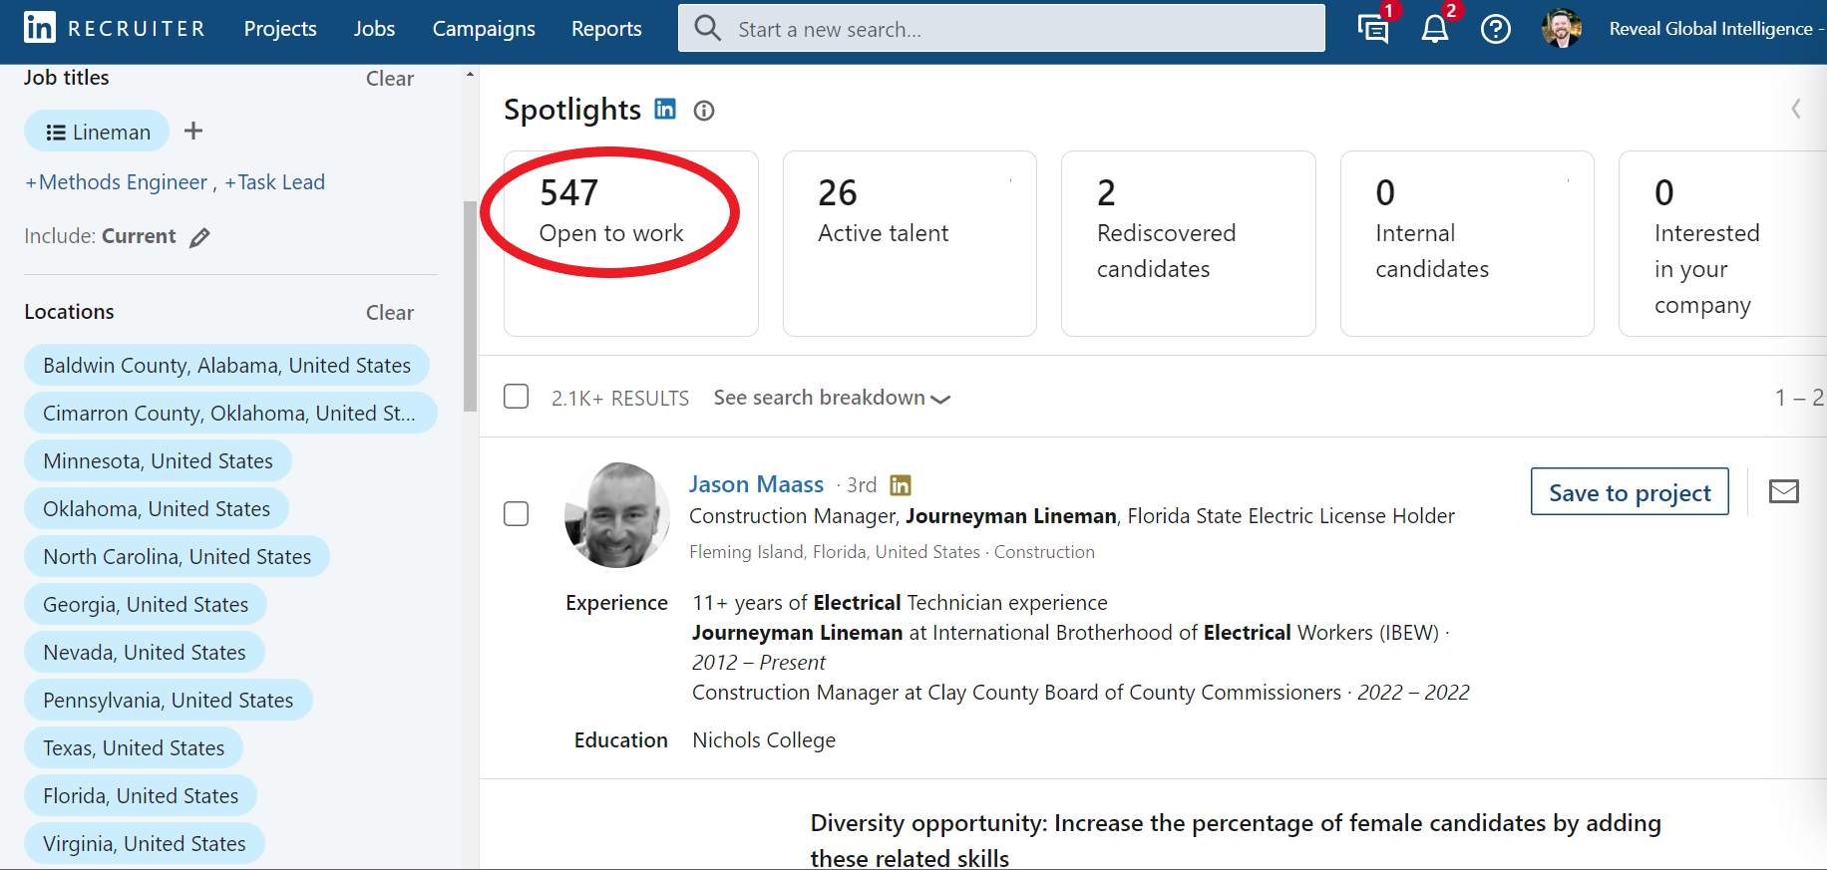
Linkedin recruiter Search

Slide 93
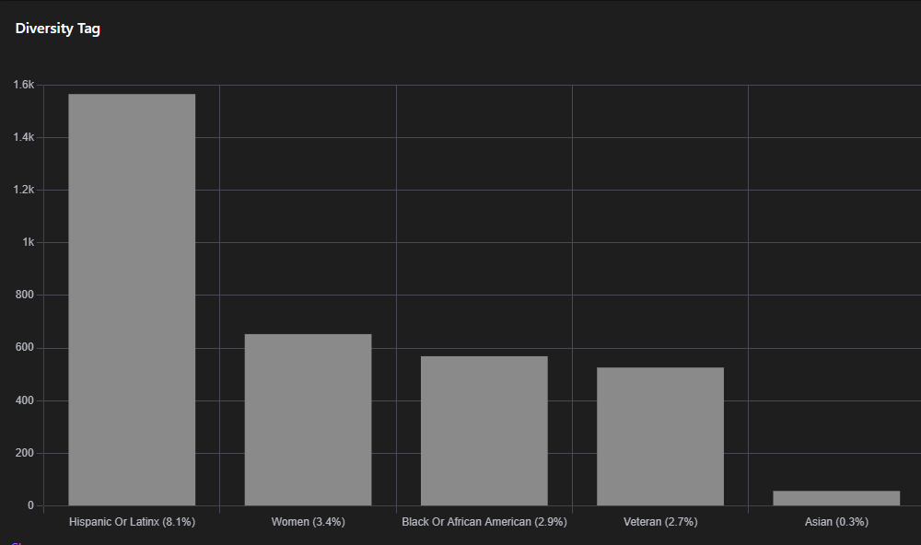
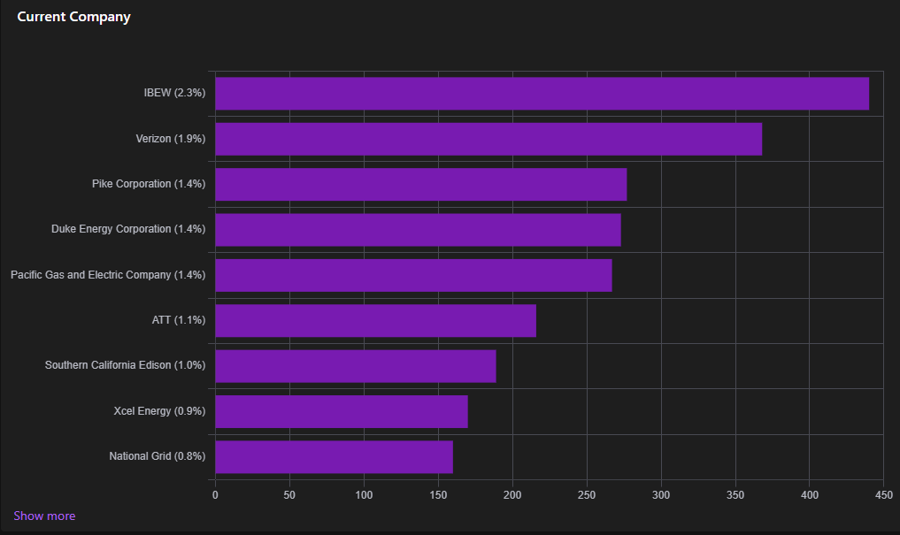
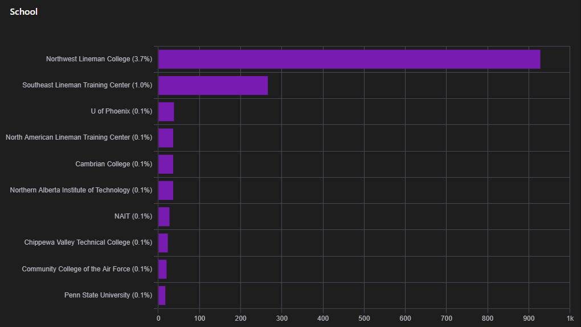
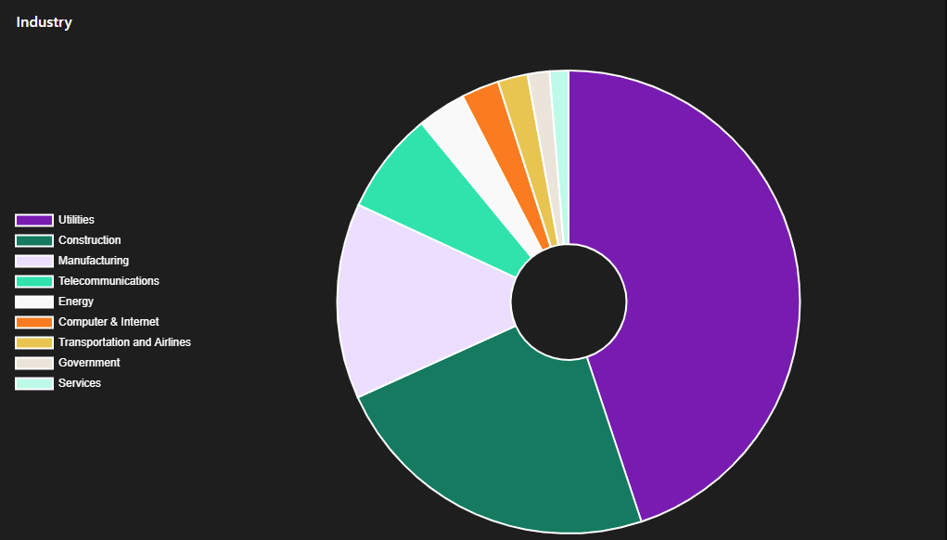
Seekout people insights

Slide 94
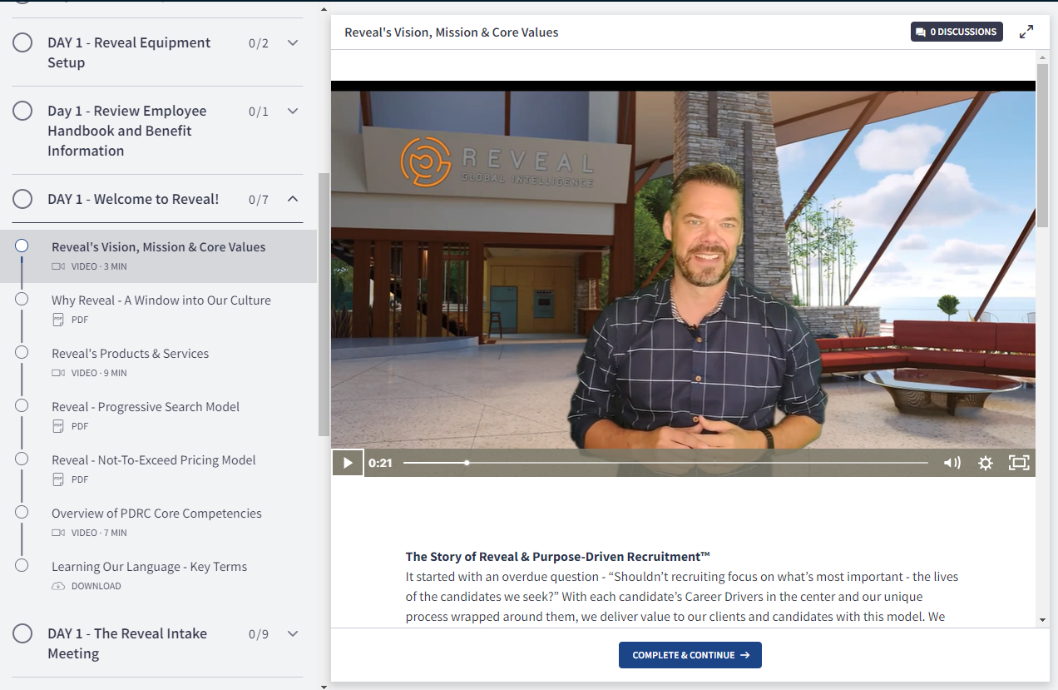
Add automation to your onboarding

Slide 95
Re-Recruit your employees

Slide 96
Re-Recruiting process
Occurs Quarterly, Bi-Annually or Annually based on the vulnerability of your workforce.
Needs to be centered around what motivates your employees about their work. (Career Drivers)
Works best when it’s a two-way conversation.
Best to align with merit increase schedules.

Slide 97
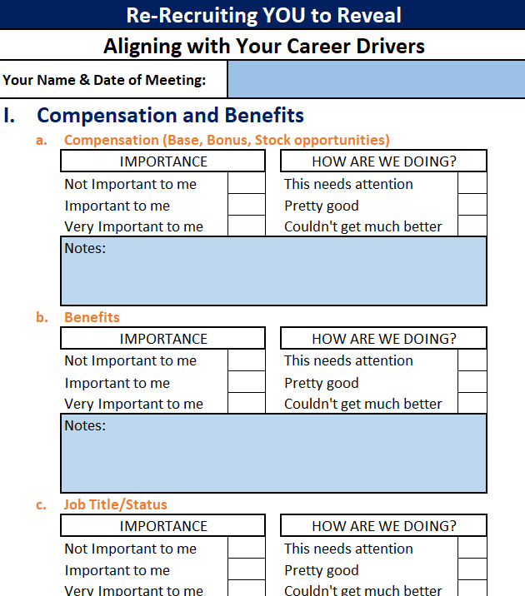
Re-recruiting form

Slide 98
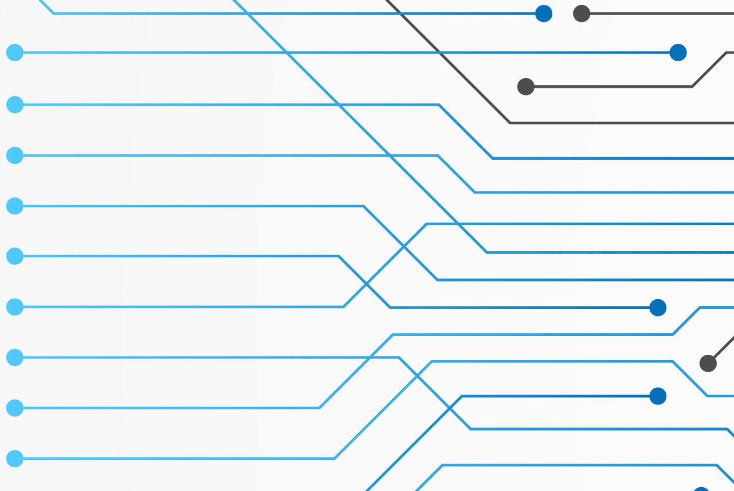
summary
Attract Emerging & Passive Talent
Hire for Skill Over Experience
Make Wise TA Technology Investments
Re-Recruit Your Talent

Slide 99
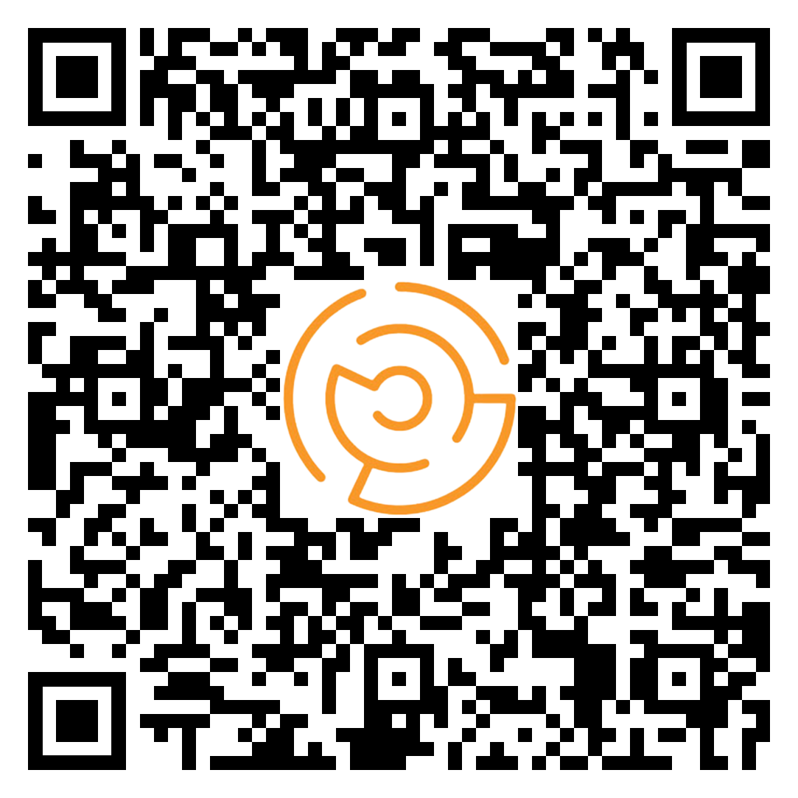
Thank You!

Slide 100
Questions/Comments?

