Slide 1
Breakfast Is Sponsored by Federated Rural Electric Insurance Exchange

Slide 2
2023 Annual Meeting

Slide 3
A Look at Distributed Energy Resources (DER) Strategies and Trends
Moderator
Steve Pascoe, Senior Product Marketing Manager, NISC,

Slide 4
David Reel, VP Technology, Brunswick EMC
Mitch Vanden Langenberg, Supervisor Load Management, Dairyland Electric Cooperative
John Lemire, VP Grid Operations and Planning, NC Electric Cooperatives
Mike High, Director Engineering Services, Blue Ridge Energy
Chris Ashley, VP Utility Sales, Energy Hub

Slide 5
Questions/Comments?

Slide 6
Brian Sloboda, Director of Utility Research and Policy, CFC
A Look at EV & DER Control & Communications Strategies

Slide 7
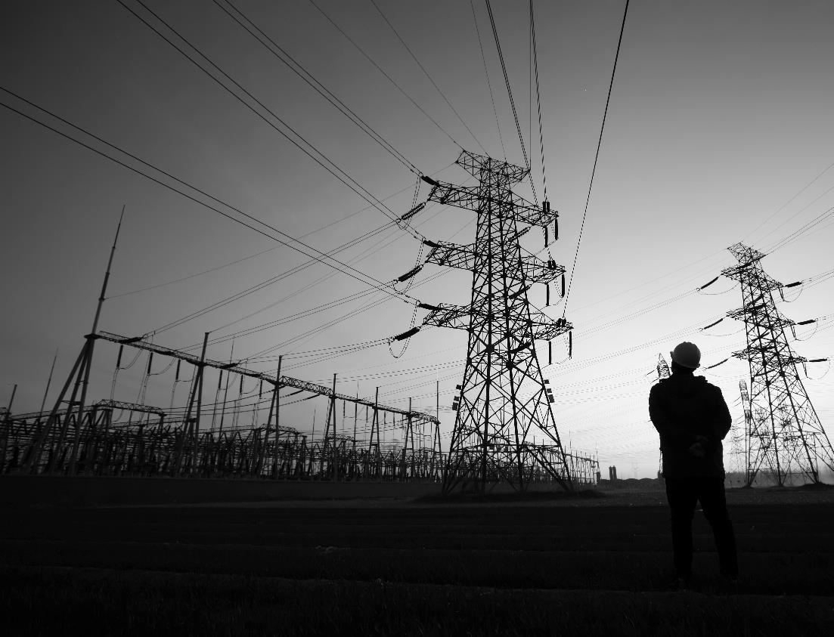
Electric Vehicle (EV) and DER Control and Communications Strategies
Brian Sloboda
Director, Utility Research & Policy
brian.sloboda@nrucfc.coop

Slide 8
Key Drivers of Transportation Change
Industry Changes
Technology
Consumers
Public Policy
Notes:
The theme of this panel, and this conference for that matter, is what’s next for electric cooperatives and their key accounts. In order to understand what is likely in store, it’s important to understand the key drivers of change in our industry.
Technology-new technologies, better technologies, cheaper technologies that add value (cost, convenience, comfort)
Consumers-they have more power and options than ever. They also have higher expectations than ever. 15 years ago I would have driven to three different stores to find the jeans in the size I want (I’m a tall skinny guy so my size is hard to find). Today I’m annoyed if I have to pay for shipping and if it arrives after 2 days of ordering it. Consumers are expecting more out of companies in terms of their environment, social, and governance structure impacts. Finally, consumers now have access to new technologies that can profoundly impact the electric cooperatives. Think LED lightbulbs reducing how much energy a business consumes, electric vehicles, solar PV, batteries, and demand response technologies. In other words, consumers are no longer passive. They are active participants in the market.
Public policy-we won’t focus as much on public policy but the reality is that the electric utility industry is still very much impacted by public policy at the federal, state, and local levels.

Slide 9
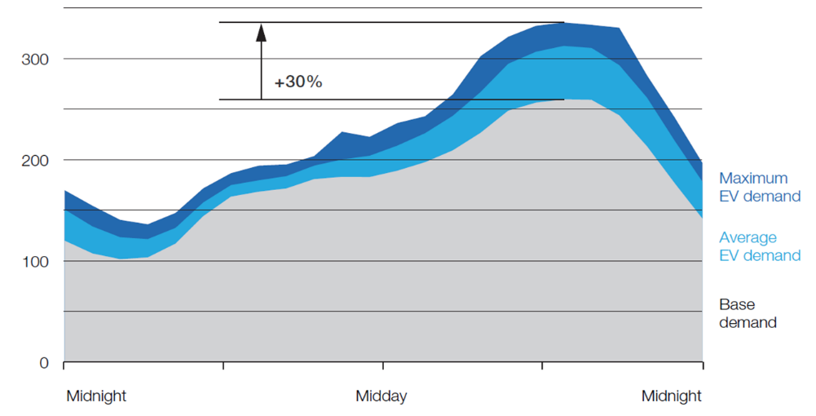
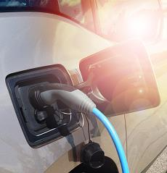
Consideration for the Distribution System
Electric Vehicles
Feeder circuit load, 150 homes with 2 vehicles per household, with 25% electric-vehicle (EV) penetration for Midwestern U.S. on a typical day in September
kW
Residential Charging
Source: McKinsey Global Energy Perspective
Notes:
Here is what EV’s can do TO coops. It’s relevant to point out this study is looking at a system in a mild month in the Midwest. It also is reverencing the 7kW Level 2 charger. A 12 kW L2 charger will just exacerbate the results.
Impact on RTO’s and seasonal capacity markets when plants are normally in outages.
NOTES: Need to manage when Evs are charged

Slide 10
Virtual Power Plant (VPP)
VPP
Network of various types of resources including distributed generation units, batteries and controllable end use devices such as water heater controllers, smart thermostats and EV chargers
VPPs can be dispatched to meet local grid needs or sold as resources into the wholesale market
Very similar to demand response
Getting a lot of headlines
Big names (Tesla, Google, Ford, etc.) entering this market
Existing U.S. pilots have focused on behind the meter storage

Slide 11
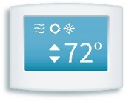
Virtual Power Plant (VPP)
VPP
VPP Operator
Local grid improvement
Wholesale market services
Resiliency
Other use cases
Notes:
Various resources controlled by one entity.

Slide 12
Average Starting State of Charge
Electric Vehicles
Source: EV Watts
Notes:
Last Updated 7/29/2022 CW

Slide 13
Communication Strategies
Electric Vehicles
Behavior Messaging
Direct Load
Control
Managed Charge

Slide 14
Communication Strategies
Electric Vehicles
Behavior Messaging
Marketing campaign based
EV rates that are often TOU rates
Messaging around cost savings & environmental benefits
Pros
Member centric
Cons
Difficult to depend on as a resource
Direct Load
Control
Managed Charge

Slide 15
Communication Strategies
Electric Vehicles
Behavior Messaging
Charger metered separately
EV specific rate
Co-op could disable charger during specified times
Pros
Maximum control for the utility
Owner could see financial savings from charging
Cons
Additional meter costs for co-op and/or member
Limited ability to understand car behavior
Owner inconvenience
Direct Load
Control
Managed Charge

Slide 16
Communication Strategies
Electric Vehicles
Behavior Messaging
Direct Load
Control
Vehicle Focused
Charger Focused
Managed Charge

Slide 17
Communication Strategies
Electric Vehicles
Managed Charge
Fleet management software vendor with API agreements with manufacturers for each model
Utility dashboard can be used to determine when vehicles are charging
Software accepts utility rate signals to manage charging for the owner
Pros
Software free (for now) to EV drivers
Cons
Not all models accept rate signals, some will be behavior messaging
Not all vendors work equally with all EV models
Vendor viability is a question
Manufacturers could terminate access
Vehicle Focused

Slide 18
Communication Strategies
Electric Vehicles
Managed Charge
Provided by DERMS vendor with APIs to smart EV chargers
Some charger manufacturers have utility portals
EV specific rates can be implemented
Pros
Many chargers have revenue grade metering built in
Greater flexibility around rate design
DERMS can be used to control other smart home devices
Could lead to future Virtual Power Plant programs
Cons
EV owners must select from an approved list of chargers
DERMS can be expensive for utility to implement
Charger Focused

Slide 19
Communication Strategies
Electric Vehicles
Behavior Messaging
Vehicle Focused
Charger Focused
Direct Load
Control
Managed Charge
Programs may be a mixture of Behavior Messaging and Managed Charge
Programs may need to grow and adapt as EV transition into more consumer groups
Little agreement on the 1 right way

Slide 20
Program Strategies
Electric Vehicles
EV Rates
Social strategies
Manage Demand Charges
Cycling
Subscription Rates
Interruptible loads
Demand Charge Holidays
EV programs will evolve over time

Slide 21
Questions/Comments?

Slide 22
Morning Break Sponsored by MDF HR Consulting

Slide 23
Funding Opportunities Under the Two Federal Infrastructure Acts (IIJA and IRA) and Tools and Tips to Secure Grants
Moderator
Angela Strickland, SVP Business and Technology Strategies, NRECA,
Mark Hayden, General Manager, Missoula Electric
Roger Gwinn, CEO, Ferguson Group

Slide 24
Questions/Comments?

Slide 25
Lunch is Sponsored by COBANK

