Slide 1
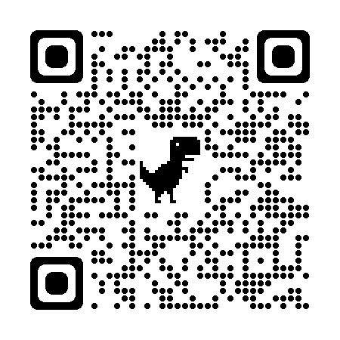
Access Federal Funding Resources Curated by TFG Grants Experts
TFG is pleased to provide resources to aid rural electric co-ops navigate the federal funding landscape. Scan the QR Code for information on the Empowering Rural America (ERA) and Powering Affordable Clean Energy (PACE) grant programs; skills to effectively prepare your priority projects for grant opportunities and Community benefits plans; and background on grant programs included in the Infrastructure, Investment and Jobs Act (IIJA) and Inflation Reduction Act.
Scan me!

